Slide 1


9th Young Scientists Summit (YSS- 2025)
School/Collage Logo
Smart Disaster Management System
Sanjay Bhandari, Manish Pandit
GoldenGate International College

Slide 2
Presentation Outline
Title Slide
Motivation & Objectives
Research Design/Methodology
Results and Discussion
Conclusion
Acknowledgements
References

Slide 3
Motivation & Objectives
Motivation
Need for Efficient Disaster Management:
Natural disasters threaten lives and property.
Current systems face delays and poor coordination.
Technological Advancements:
IoT enables real-time monitoring and automated responses.
Objectives
Real-Time Monitoring:
Develop continuous environmental monitoring with sensors.
Automated Alerts:
Implement immediate notifications for danger thresholds.
Automated Rescue Operations:
Reduce manual intervention to enhance response times.
Enhance Preparedness:
Provide a user-friendly interface for alerts and monitoring.

Slide 4
Research design/ Methodology
Development Approach:
Utilized an Agile Development methodology for iterative design and testing of the system.
Data Collection:
Integrated vibration and water level sensors for real-time environmental monitoring.
Collected sensor data to predict disasters using machine learning.
AI Model Implementation:
Employed Random Forest Classification using scikit-learn for disaster prediction based on sensor readings.
Trained the model on historical disaster data to improve accuracy.
API Integration:
Used the OpenWeatherMap API for weather data to enhance prediction accuracy.
Integrated the USGS API for real-time earthquake data to inform the model.
Testing and Validation:
Conducted field tests to validate sensor accuracy and model performance.
Simulated disaster scenarios to assess system responsiveness and effectiveness.
Start
Data Collection
Clean and preprocess the collected data for analysis..
Train the model with historical disaster data.
Evaluate model performance using metrics (accuracy, precision, recall).
Integrate the model with real-time sensor data and APIs.
Conduct field tests to validate system performance.
Deploy the Smart Disaster Management System for real-world use.
End

Slide 5
Result and Discussion
Model Performance:
Accuracy: The Random Forest model achieved an accuracy of 100% in predicting disaster events based on sensor readings.
Key Metrics:
Precision: 100%
F1 Score: 100%
Sensor Data Insights:
Analyzed real-time data from vibration and water level sensors to predict potential disasters.
Vibration levels indicating seismic activity and water levels signaling flood risks.
API Contributions:
Integration with the OpenWeatherMap API provided critical weather data, enhancing prediction capabilities.
The USGS API supplied real-time earthquake data, improving responsiveness to seismic threats.
Impact of Predictions:
Early warning alerts can significantly reduce response times and improve disaster management.
Potential to save lives and minimize property damage through timely interventions.
Challenges and Limitations:
Data quality issues affected model training and predictions.
Real-time processing requirements posed technical challenges during implementation.

Slide 6
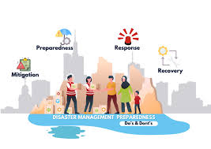
Conclusion
Key Achievements:
Developed the Smart Disaster Management System (SDMS) to enhance disaster preparedness in Nepal.
Impact of Technology:
Utilized real-time sensor data and machine learning (Random Forest) for accurate disaster predictions.
Integration of Data Sources:
Enhanced predictive capabilities through APIs from OpenWeatherMap and USGS.
Community Safety:
The system provides timely alerts, potentially saving lives and minimizing property damage.
Future Directions:
Mobile app development , multiple sensor integration for different places

Slide 7
Refrenceses
Khan, F., & Abbasi, T. (2019). A review of disaster management: The role of technology in disaster risk reduction. International Journal of Disaster Risk Reduction, 34, 1-10. https://doi.org/10.1016/j.ijdrr.2018.11.015
OpenWeatherMap. (2024). OpenWeatherMap API Documentation. https://openweathermap.org/api
US Geological Survey (USGS). (2024). USGS Earthquake Hazards Program. https://earthquake.usgs.gov
scikit-learn. (2024). scikit-learn: Machine Learning in Python. https://scikit-learn.org/stable/
Espressif Systems. (2024). ESP32 Technical Reference Manual. https://docs.espressif.com/projects/esp-idf/en/latest/esp32/api-reference/index.html
Sensing Technologies for Water Level Monitoring: A Review. (2020). Journal of Environmental Management, 260, 110-120. https://doi.org/10.1016/j.jenvman.2020.110120

Slide 8
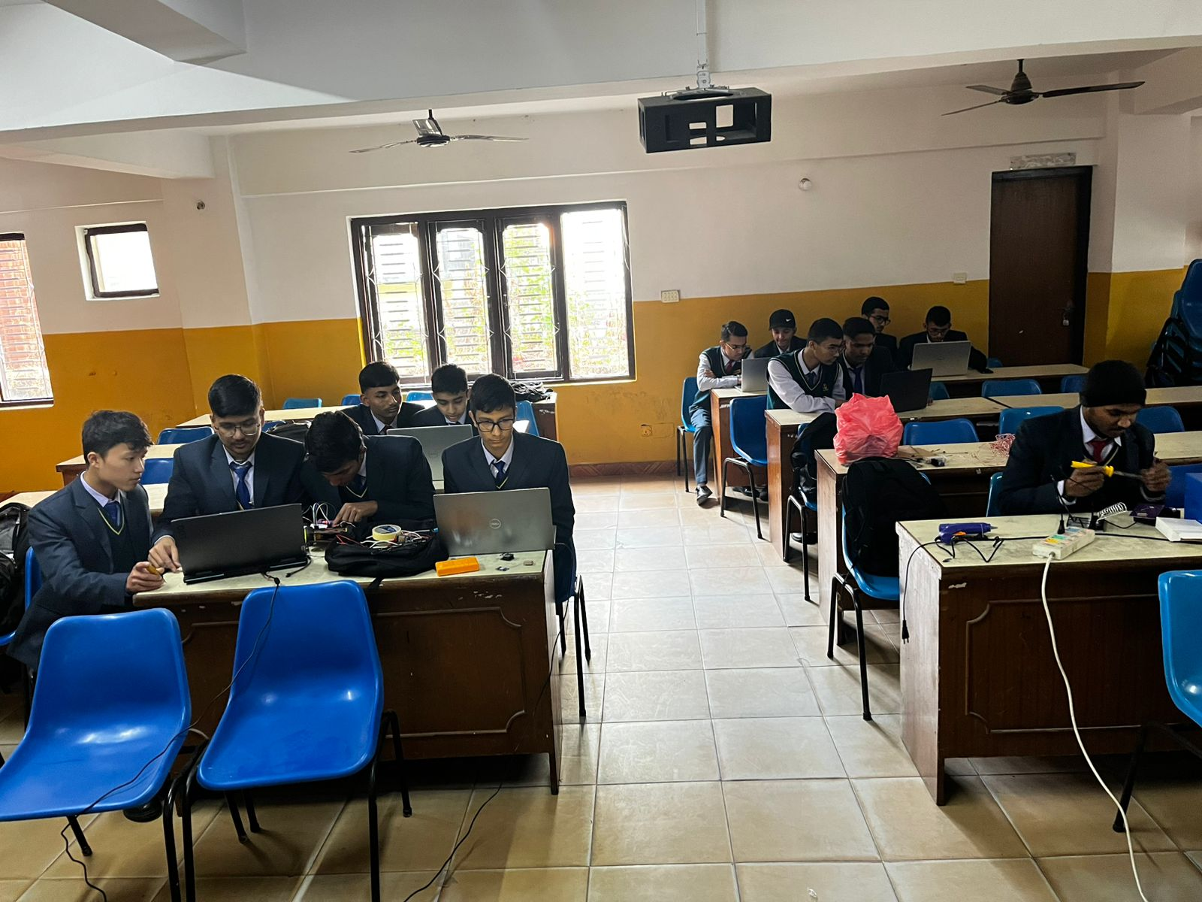
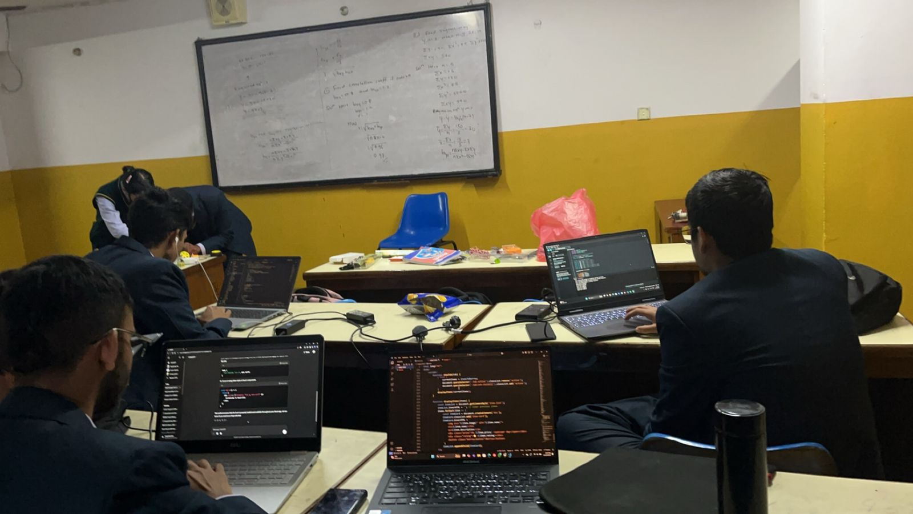
Acknoldegment
Dibas Khanal:
Special thanks to Dibas Khanal, who has been a supportive figure and has always helped us during difficult times.
Friends from S11:
Grateful to my friends from S11 for their encouragement and collaboration throughout this project.
Brothers from D11:
Appreciation for my brothers from D11 for their support and camaraderie during our research journey.
GoldenGate College:
Thankful to GoldenGate College for providing the resources and academic environment that facilitated this research.
GoldenGate Robotics Club:
Acknowledgment of the GoldenGate Robotics Club for their support and collaboration in developing the Smart Disaster Management System.

Slide 9
Thank You

